Slide 1
This sample started off as ZrNiIn3
After synthesis, it was annealed for nearly 1 week. When we opened the sample, excess indium had vapor transported to the opposite end of the ampoule. The remaining material contained regions with different colors: white, black, gold, and gray shiny. The white and black regions, from EDS, were definitely ZrO2. The gold-rich pieces showed, by far, the strongest superconducting signal but that region was only ~1 mg in size (tiny). The shiny gray phase was

Slide 2
EP3043A-black piece

Slide 3
EP3043A-black piece
No nitrogen detected but oxygen definitely was at many points. Point 4 contained Si. Due to the location on the back side of white definite ZrO2, the black is likely from a thin layer of ZrO2 on the surface of Zr particles. In and Ni were not detected in some scans and unusually weak.
O N Si Ni Zr In
001 26.64 nd 0.50 72.31 0.55
002 30.47 nd nd 69.53 nd
003 31.48 68.52
004 17.25 nd 5.25 11.93 60.97 4.61
005 29.13 70.87
006 17.48 11.68 60.19 10.65
Average 25.41 0.00 5.25 8.04 67.06 5.27
Deviation 6.44 0.00 6.53 5.19 5.08

Slide 4
EP3043A-white piece
Definitely ZrO2
Formula mass% Atom% Sigma Net K ratio Line
O 29.12 70.08 0.39 2783 0.0004404 K
Zr 70.88 29.92 0.76 30970 0.0034228 L
Total 100.00 100.00

Slide 5
EP3043A-gold piece
No evidence of nitrogen. This was from the gold piece but I don’t think I was sampling the gold portion of it. This piece seemed to look gold-ish but also black-ish so it was hard to tell if I was sampling the correct stuff. This piece had unusually small amounts of In and Ni
O Ni Zr In
001 39.24 60.76
002 35.61 0.69 63.59 0.10
003 34.55 0.26 64.79 0.40
Average 36.46 0.48 63.05 0.25
Deviation 2.46 0.30 2.07 0.21

Slide 6
Surface of big gold piece
Over-representation of Zr with <10 at. % In and very little Ni (<5 at. %). Carbon is heavily over-represented and, unfortunately, it heavily overlaps significantly with the N peak. There was some nitrogen and oxygen present, though (small peak upon zooming). When C, O, N, Zr, Ni, and In were included, it was ~36 at. % C , ~14 at. % N, 7 at. % O, 43 at. % Zr. Quantification of C, O, N can’t be trusted. Why is the microstructure so different and rod-like? Next time, look at it from the side. It is possible that the rod surfaces are oxidized/different from rods, themselves. I was originally trying to avoid screening of x-rays.
Ni Zr In
001 4.27 92.51 3.22
002 100.00
003 1.22 90.19 8.59
Average 2.74 94.23 5.91
Deviation 2.16 5.13 3.80

Slide 7
Surface of gold piece
O C N Ni Zr In
001 6.40 34.43 15.66 1.97 40.34 1.21
002 42.69 12.69 44.62
003 7.00 31.14 12.32 0.64 45.12 3.79
Average 6.70 36.09 13.55 1.30 43.36 2.50
Deviation 0.42 5.95 1.83 0.94 2.63 1.83
Ni Zr In
001 4.27 92.51 3.22
002 100.00
003 1.22 90.19 8.59
Average 2.74 94.23 5.91
Deviation 2.16 5.13 3.80

Slide 8
The golder side of a piece had a very different microstructure (confirmed gold by optical scope and photo)
Backscatter
Secondary electrons
Darker ends of rods from backscatter are consistent with a different oxide layer on the surface. I’d like to do more EDS on the light portions but it looks like the positions I got should be

Slide 9
This location was on the big gold piece farther back
These pieces were extremely Zr-rich with some O detected at points. There were no sigs of Nitrogen. The In and Ni contents were lower than expected.
O Ni Zr In
001 100.00
002 7.14 87.50 5.37
003 7.93 88.73 3.34
004 1.84 96.30 1.86
005 10.12 18.81 68.51 2.57
Average 10.12 8.93 88.21 3.28
Deviation 0.00 7.12 12.18 1.52

Slide 10
Data 1/11

Slide 11
Distinctive rod-like microstructure near higher concentration of gold-colored grains. It was difficult to clearly see the sides of these rods
Bright region might be a topography affect

Slide 12
Backscatter
Secondary

Slide 13
Looks like Zr mostly, which is hexagonal—but why would it not be reacted? ZrC T_{c}=1.8-3.7 K and is cubic and black (more likely C deposition from beam)
O C Ni Zr
001 59.71 40.29
002 12.93 48.47 0.71 37.90
Average 12.93 54.09 0.71 39.10
Deviation 0.00 7.95 0.00 1.69

Slide 14
Rod Ends-golder surface
O C N Ni Zr In
001 5.83 44.43 14.03 0.37 35.02 0.32
002 6.91 54.18 38.91
Average 6.37 49.31 14.03 0.37 36.96 0.32
Deviation 0.76 6.89 0.00 0.00 2.75 0.00

Slide 15
O C N Zr
001 8.14 39.95 16.92 34.98
002 40.09 23.32 36.59
Average 8.14 40.02 20.12 35.78
Deviation 0.00 0.10 4.52 1.13

Slide 16
In and Zr are clearly present but the sample is still very Zr-rich.
Ni Zr In
001 0.19 68.21 31.60
002 0.86 69.17 29.97
003 0.23 67.86 31.90
Average 0.43 68.41 31.16
Deviation 0.37 0.68 1.04

Slide 17
Not all parts of the sample were like this but, for the rod-like microstructure, these results were common.

Slide 18
Darker deeper portion of the sample
Formula mass% Atom% Sigma Net K ratio Line
Ni* 0.86 1.38 0.17 210 0.0000597 K
Zr 78.85 81.88 0.75 38188 0.0042253 L
In* 20.29 16.74 0.42 6699 0.0009920 L
Total 100.00 100.00
In-rich nature not surprising given starting composition but SO MUCH Zr!

Slide 19
Day 3
Another piece of the golder sample

Slide 20
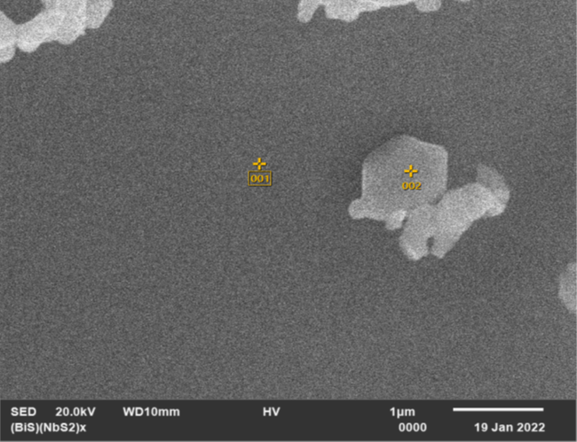
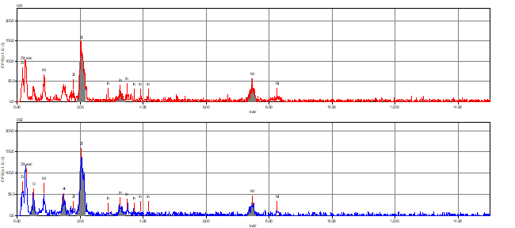

Img 4-Definite Zr-In-Ni phase with some Al2O3 impurity (from cleaning). Looks like Zr2InNi, never reported phase

Slide 21
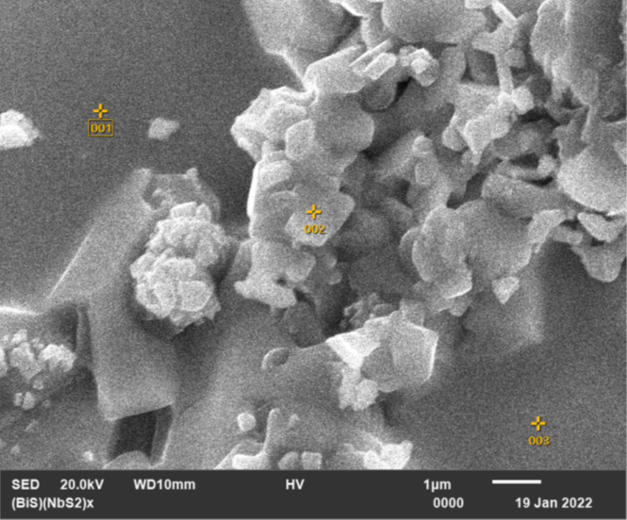
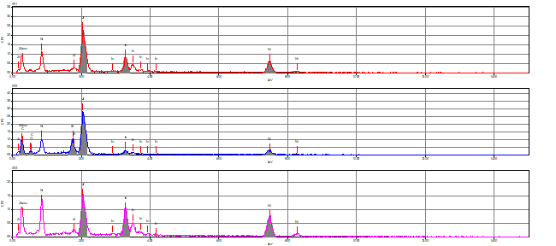

Img 5
Zr2InNi has never been reported!
Note the oddly flat surface.

Slide 22
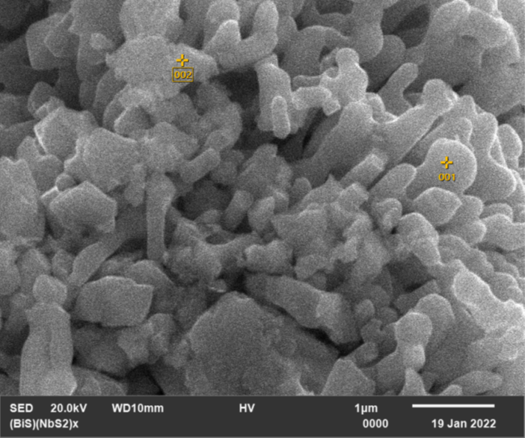
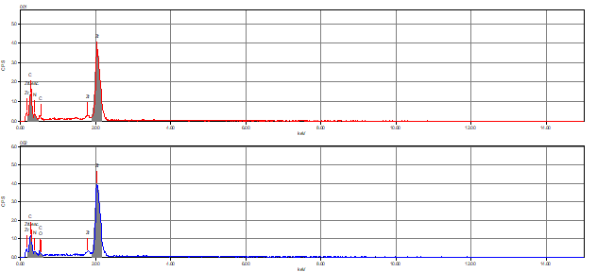
Img 6

Slide 23
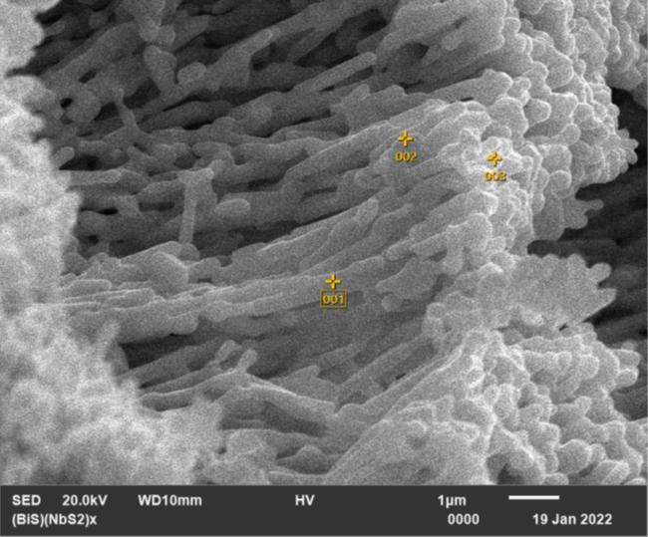
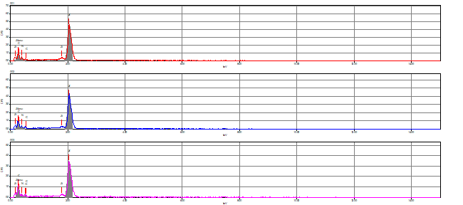

Piece 2 (same as day 2), point 7
Some nitrogen is present but mostly Zr
Zr either didn't melt (really odd) or hexagonal ZrN? Strange.

Slide 24
Next Steps
Use 10 keV to minimize depth of signal?
  Why am I really only seeing Zr in the rods?
  ZrN is the right color but it is cubic
Look at additional pieces of sample with gold flecks
  Might help clarify how representative these Zr rod-like regions are.
  I have already looked at 3 pieces but identifying regions with more gold and orienting them so I can clearly identify and image these regions has been tricky.
Arc melt in nitrogen
  Look for similar rod-like microstructure

