Slide 1
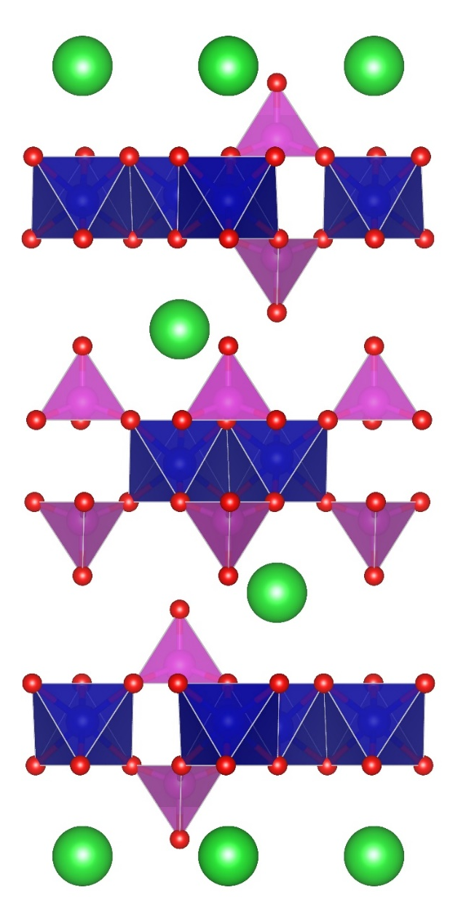
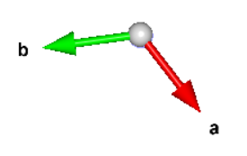
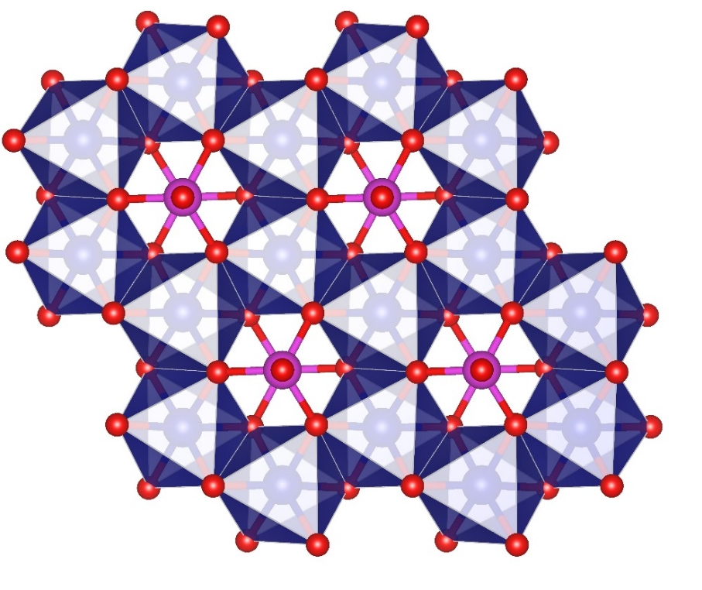
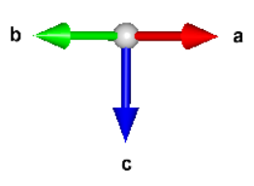
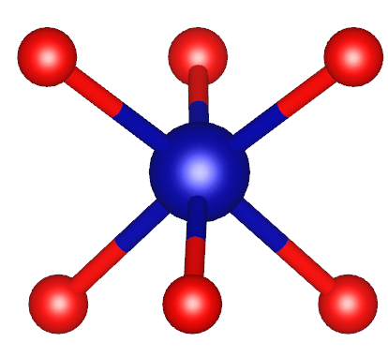
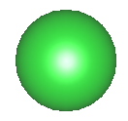
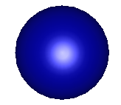
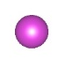

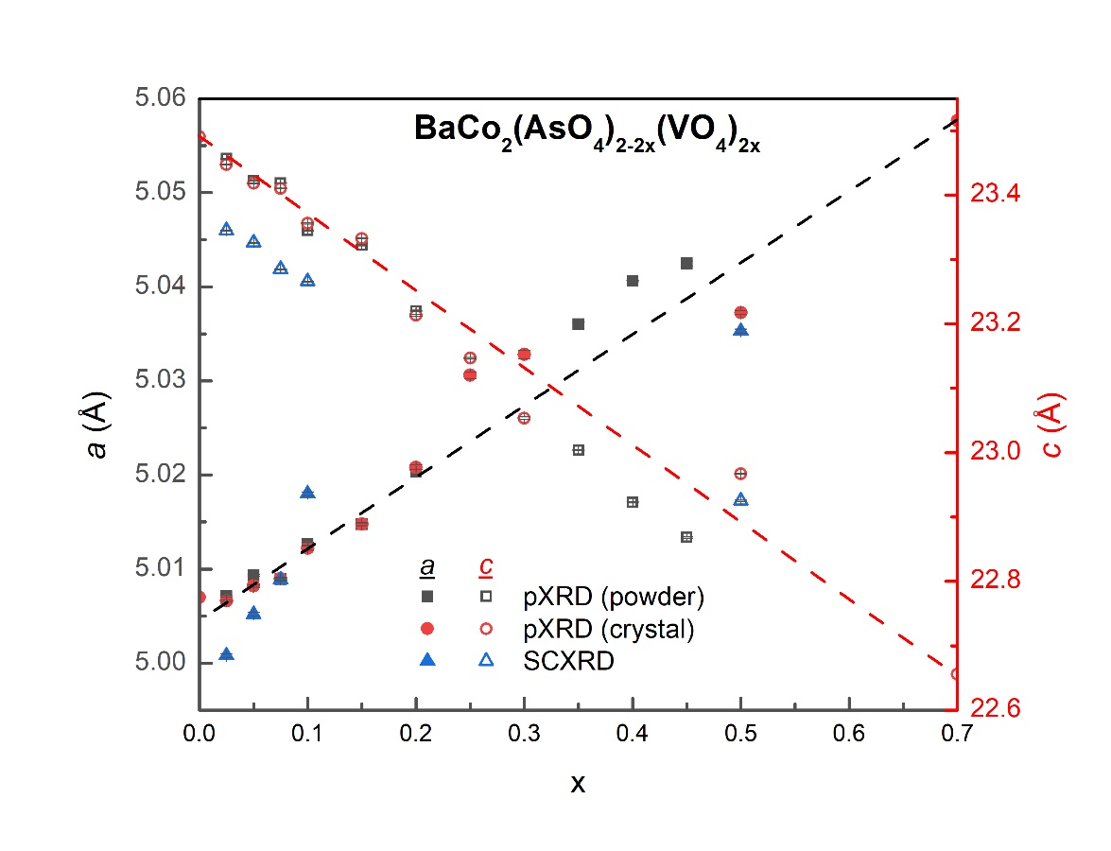
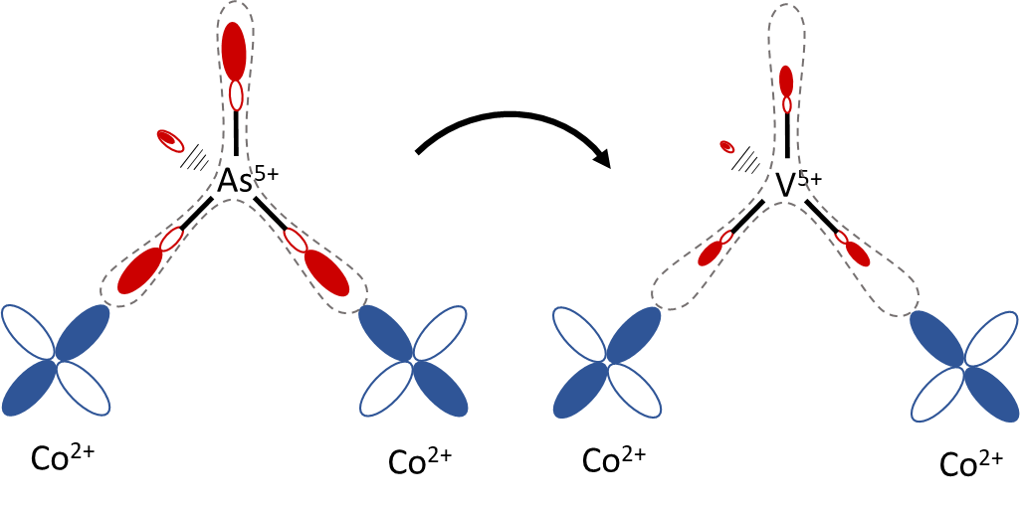
a)
b)
c)
b
b
a
d₁
a
c
O1
O2
d₃
d₂
Ba
Co
e)
f)
O²⁻
As
J₃
O
^{87.7°}
d)
J₁
+V
Co²⁺
Co²⁺
J₁ superexchange (FM)
g)
+V
O²⁻
O²⁻
J₃ third nearest-neighbor exchange (AFM)

Slide 2
O²⁻
As⁵⁺
+V
V⁵⁺
^{87.7°}
+V
Co²⁺
Co²⁺
J₁ superexchange (FM)
Co²⁺
Co²⁺
Co²⁺
Co²⁺
J₃ third nearest neighbor exchange (AFM)

Slide 3
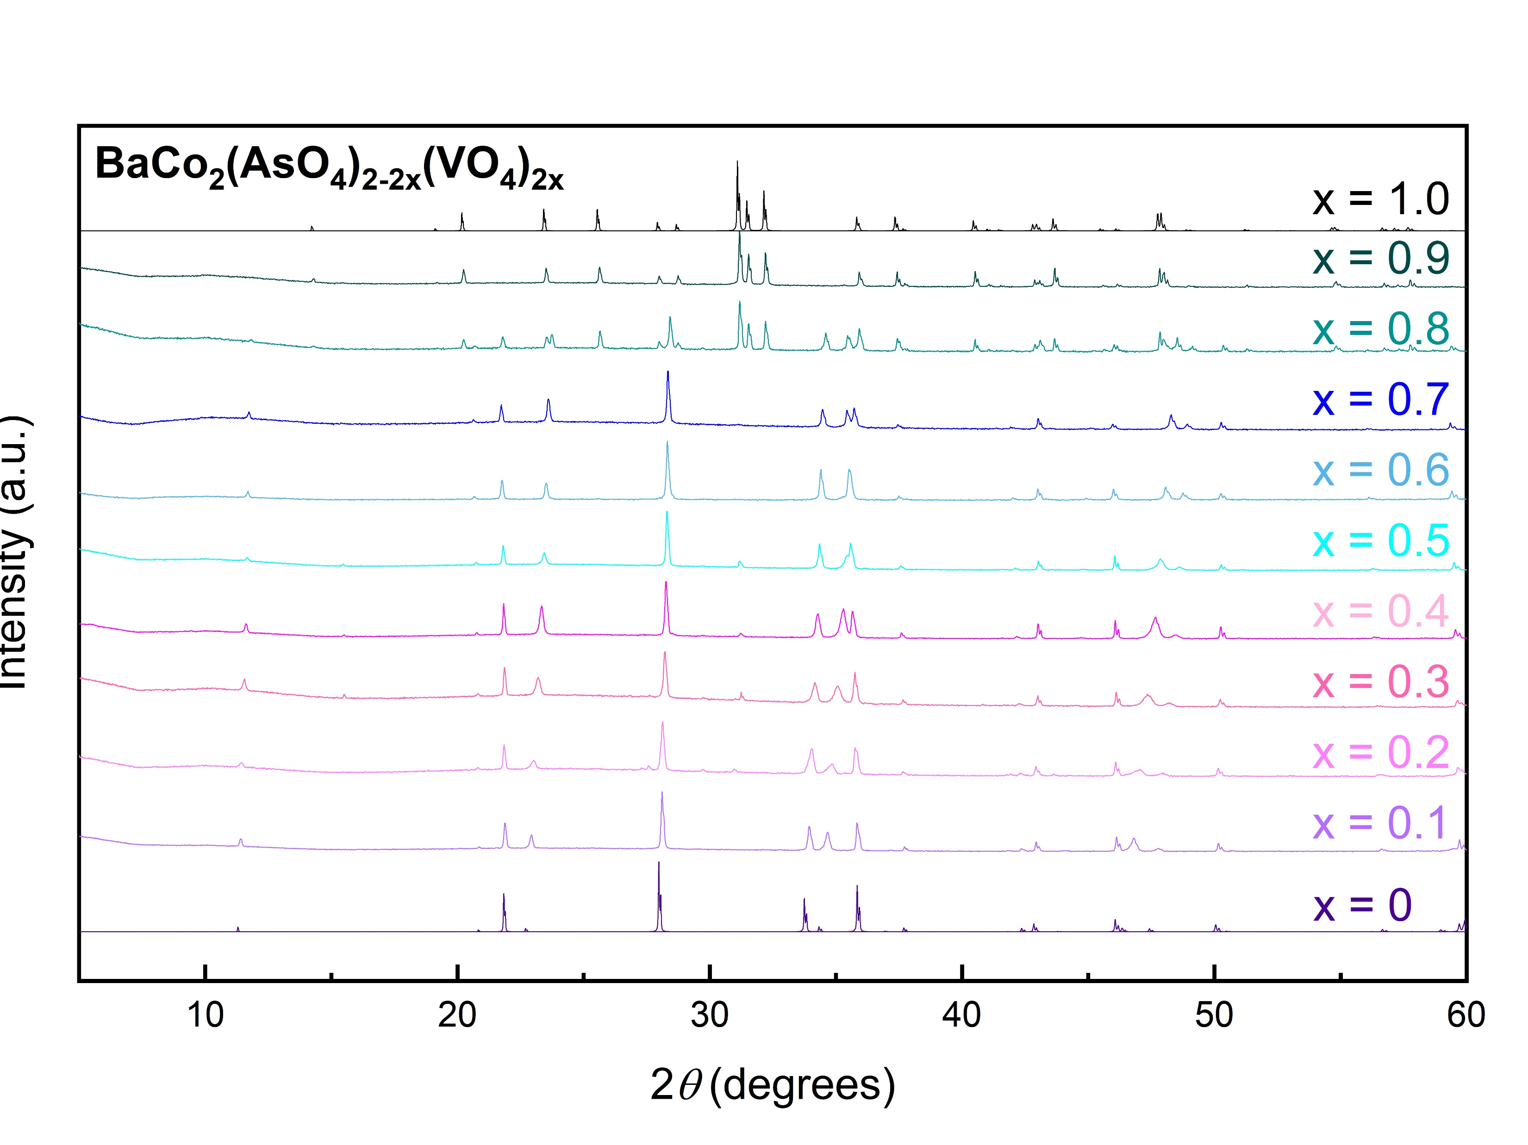
*
*
*
*
*
*
(2-10)
(003)
(006)
(009)
(0012)

Slide 4
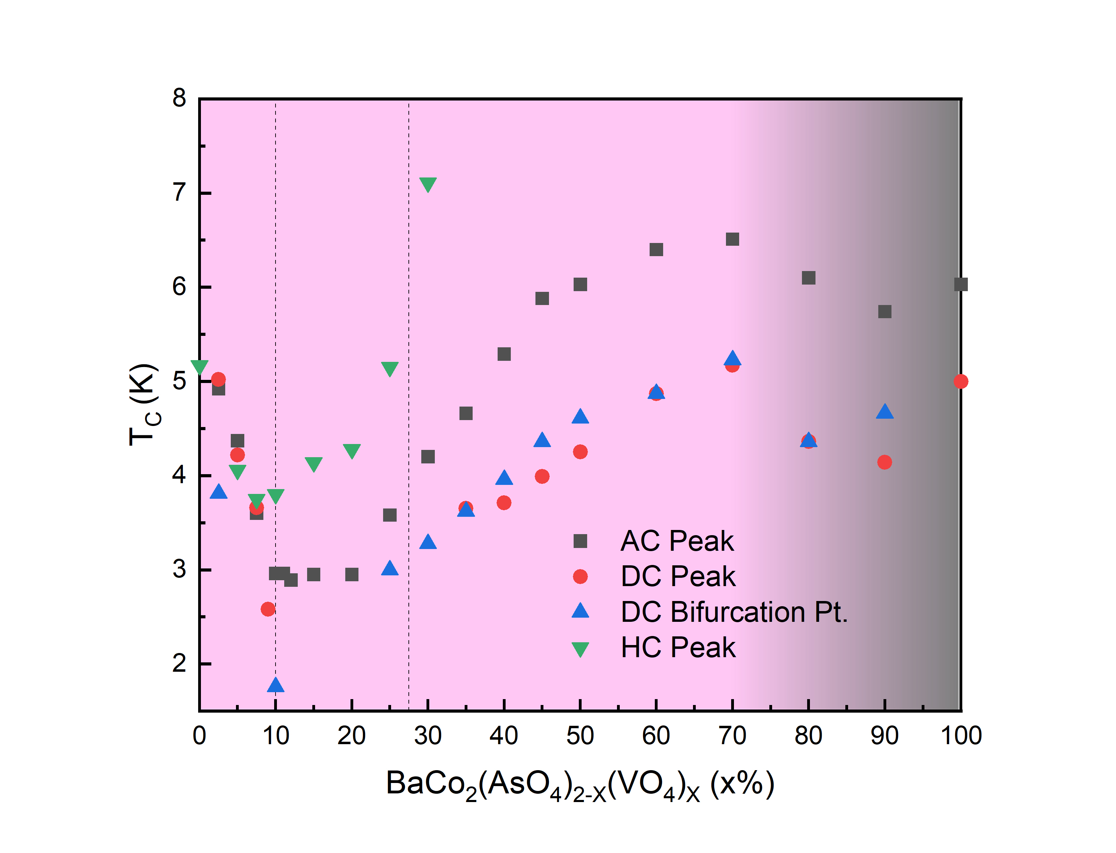

Slide 5
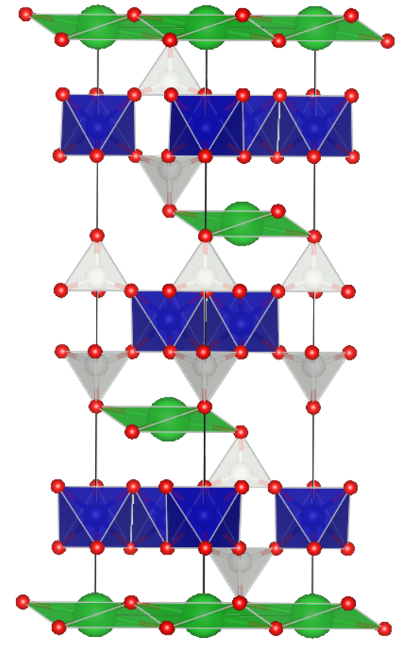
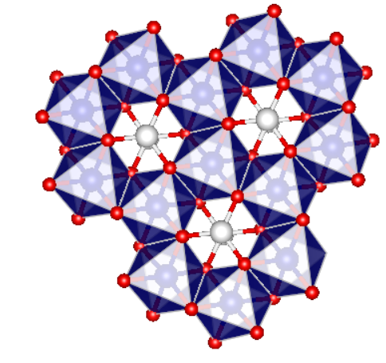
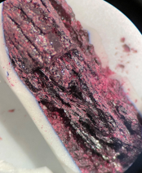
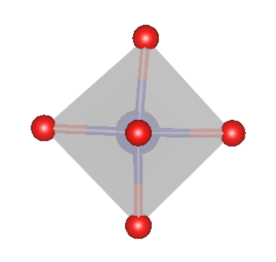
BaCo₂(AsO₄)₂ (BCAO)
BaCo₂(AsO₄)₂, or BCAO, has been one of the most intensely-studied Kitaev spin liquid candidates in recent years.
Believed to possess only weak Heisenberg and other non-Kitaev interactions.
  Largely owing to the slight trigonal distortion of the Co octahedra.
Interplanar AFM interactions are largely suppressed by the application of a weak (0.5 T) field, producing a nonmagnetic state.
92.3°
85.7°
Notes:
Another material system for which existing synthetic methods have been rather limited, BaCo2(AsO4)2, has been one of the most intensely studied Kitaev spin liquid candidates of the past several years.
The honeycomb lattice in BaCo2(AsO4)2, or BCAO, consists of edge-sharing, lightly-distorted CoO6 octahedra, which are believed to account for the high degree of planar anisotropy observed in its magnetic behavior at low temperatures.
BCAO orders antiferromagnetically at TN = 5.4 K, with dominant antiferromagnetic interlayer coupling and in-plane ferromagnetic exchange, and has been shown to transition to a nonmagnetic state with the application of only a relatively weak field, suggesting the presence of fairly weak non-Kitaev interactions in the material.

Slide 6
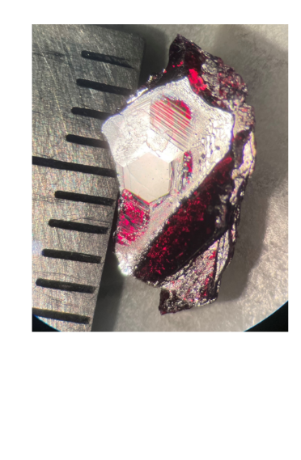
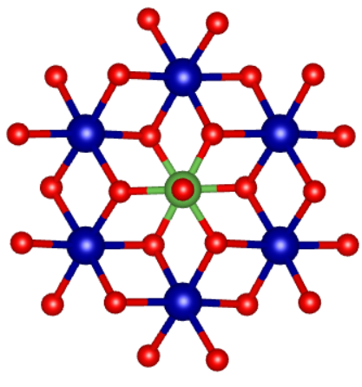
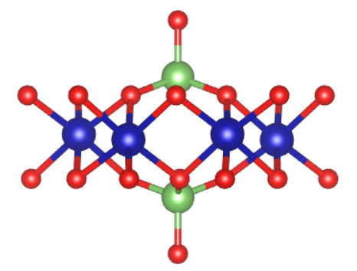

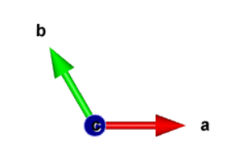
Substitutions
Pb
Sr
[TO₄]³⁻ | T-O bond length
(PO₄)³⁻ | 1.50-1.60 Å
(AsO₄)³⁻ | 1.70 Å
(VO₄)³⁻ | 1.72 Å
(NbO₄)³⁻ | 1.82 Å
(SbO₄)³⁻ | 1.95 Å
P
V
Sb
In order to reduce the degree of the trigonal distortion of the Co octahedra, various substitutions were attempted.
The most promising appears to be partial substitution of As with V.
  Correspond to a roughly 0.95 Å contraction and 0.01 Å expansion of the c-axis and a-axis, respectively.
Samples crystallize nicely from the melt, without a particular temperature gradient or cooling rate.
BaCo₂(AsO₄)₂
b
a
Rep. BCAO-V-10% crystal

Slide 7
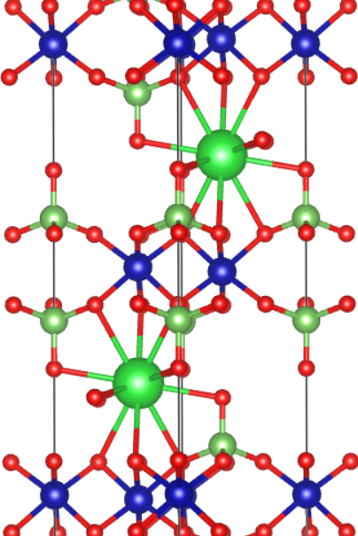

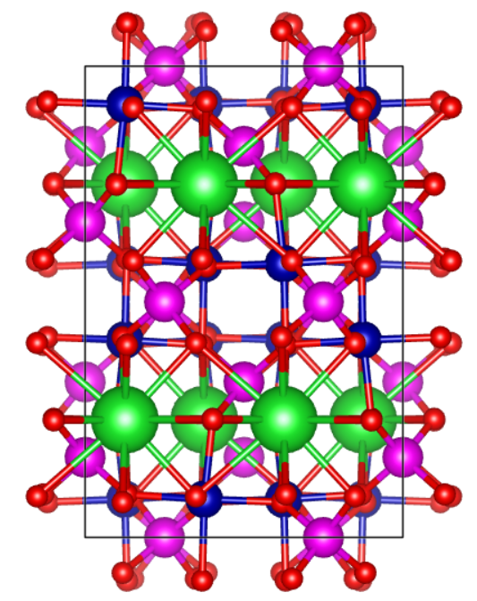

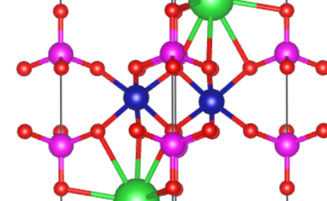
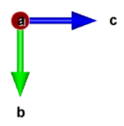
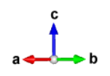
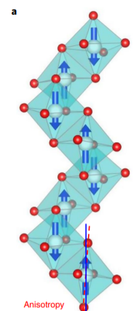
Ba
As
Co
O
V
BaCo₂(AsO₄)₂
R-3
BaCo₂(AsO4)_{>0.67}(VO₄)_{<1.33}
R-3
BaCo₂(VO₄)₂
I41/acd
XXZ model
T_{N} = 5.5 K
(1-D spin chain → 3-D AF-LRO)
Strongly anisotropic magnetism (easy c-axis)
AFM order suppressed by a 3.9 T field (to incommensurate phase).
JKΓ/XXZ model
T_{N} = 5.4 K
Strongly anisotropic magnetism (easy c-axis)
LRO suppressed by a 0.55 T field.
Faure, Q, et al, Nat. Phys., 14, 716-722 (2018)
Notes:
Ba: 6-coord → 12-coord

Slide 8
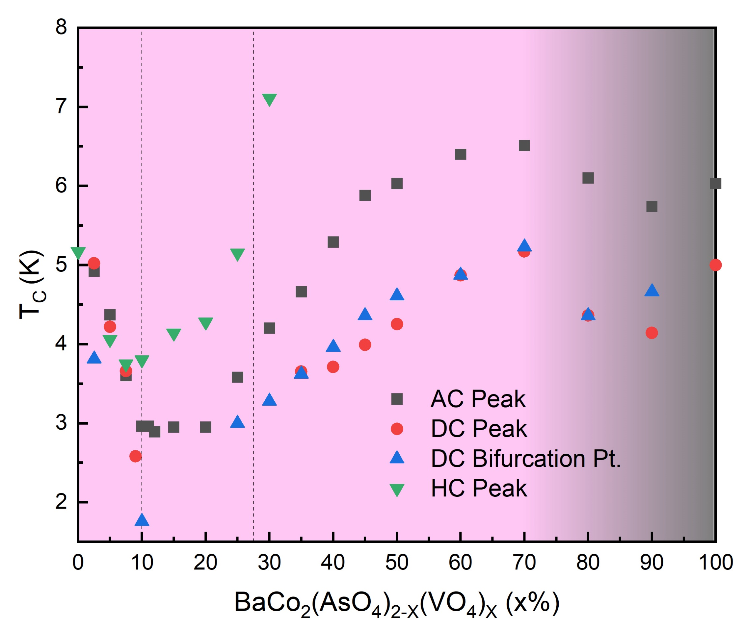
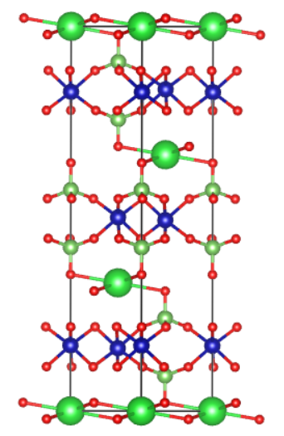
Hysteresis
Metamagnetism
a
c
b
c
a
b
BaCo₂(AsO₄)₂
BaCo₂(VO₄)₂

Slide 9
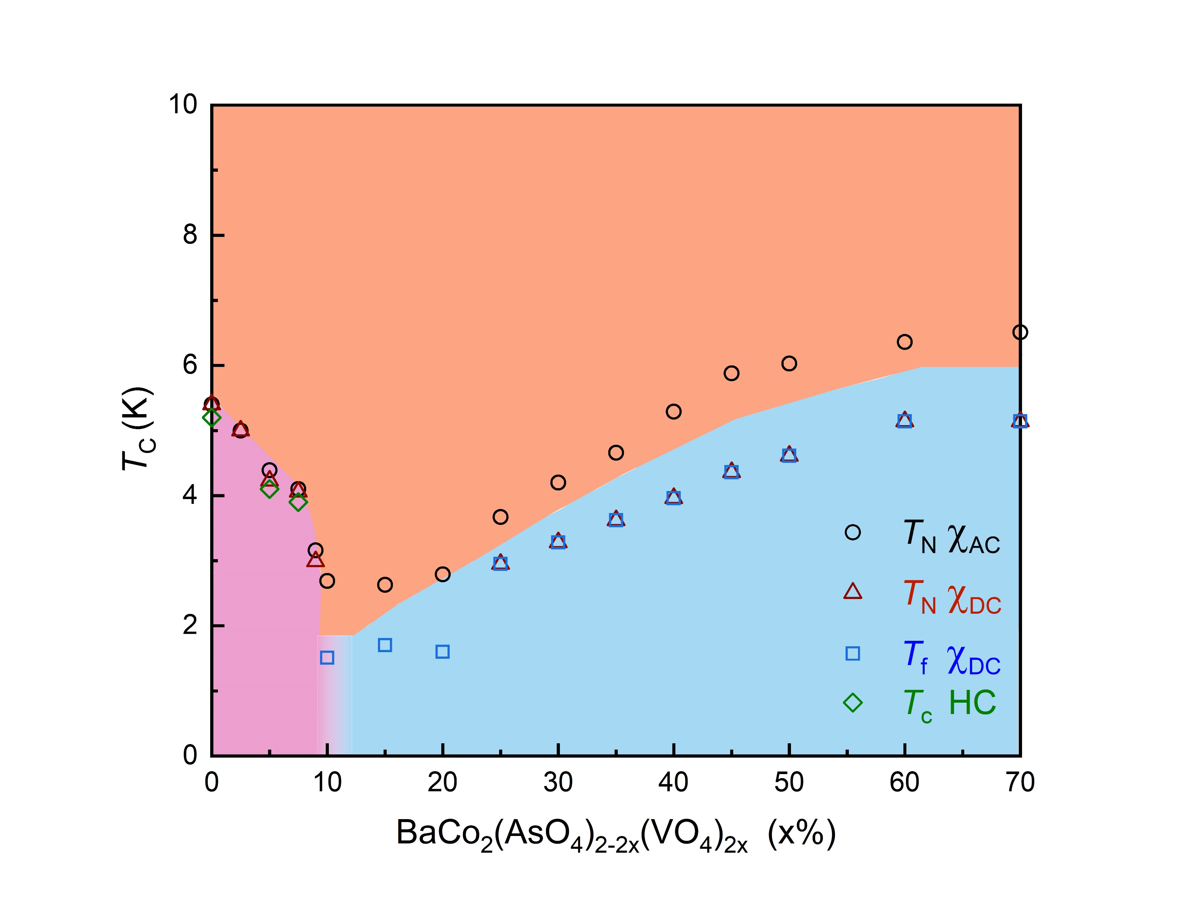
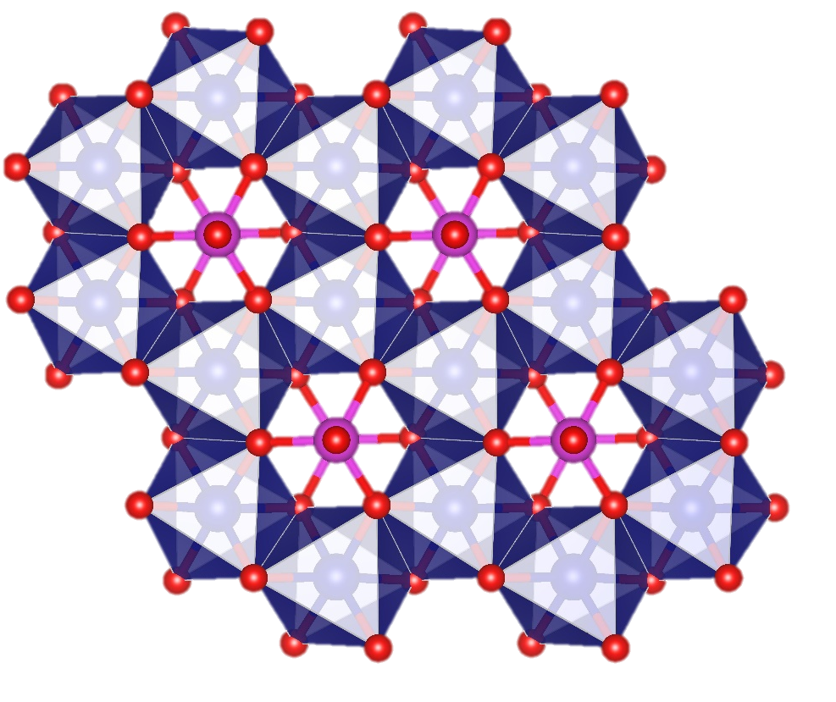
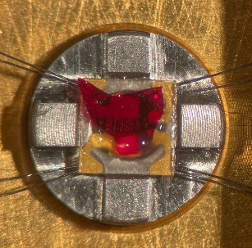
BaCo₂(AsO₄)_{2-2x}(VO₄)_{2x}
Paramagnet
Critical
point
AFM
Order
Spin glass

Slide 10
a)
b)

Slide 11
pXRD (powder) – first heat
pXRD (crystal) – second heat/melt
SCXRD from the refinement assuming
no V (Max’s suggestion so far).

Slide 12
pXRD (powder) – first heat
pXRD (crystal) – second heat/melt
SCXRD from the refinement assuming
no V (Max’s suggestion so far).

Slide 13
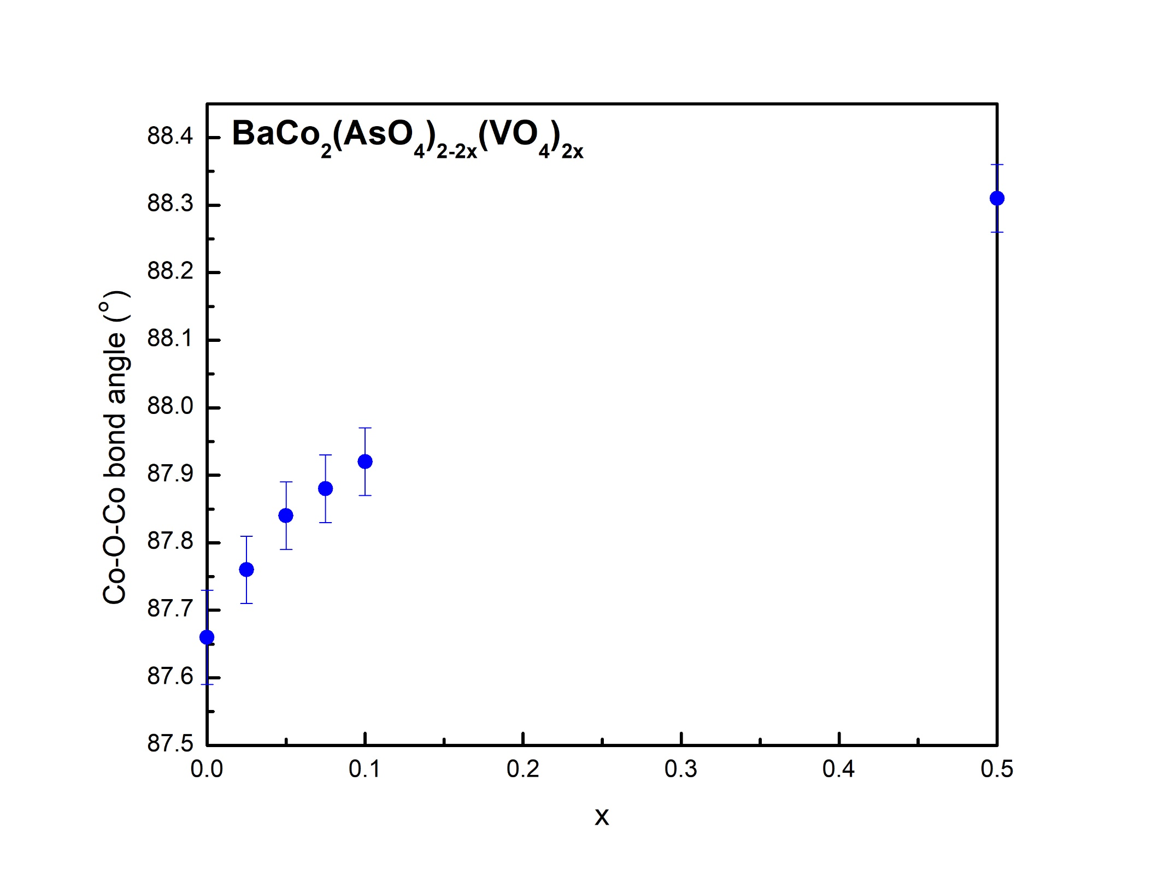
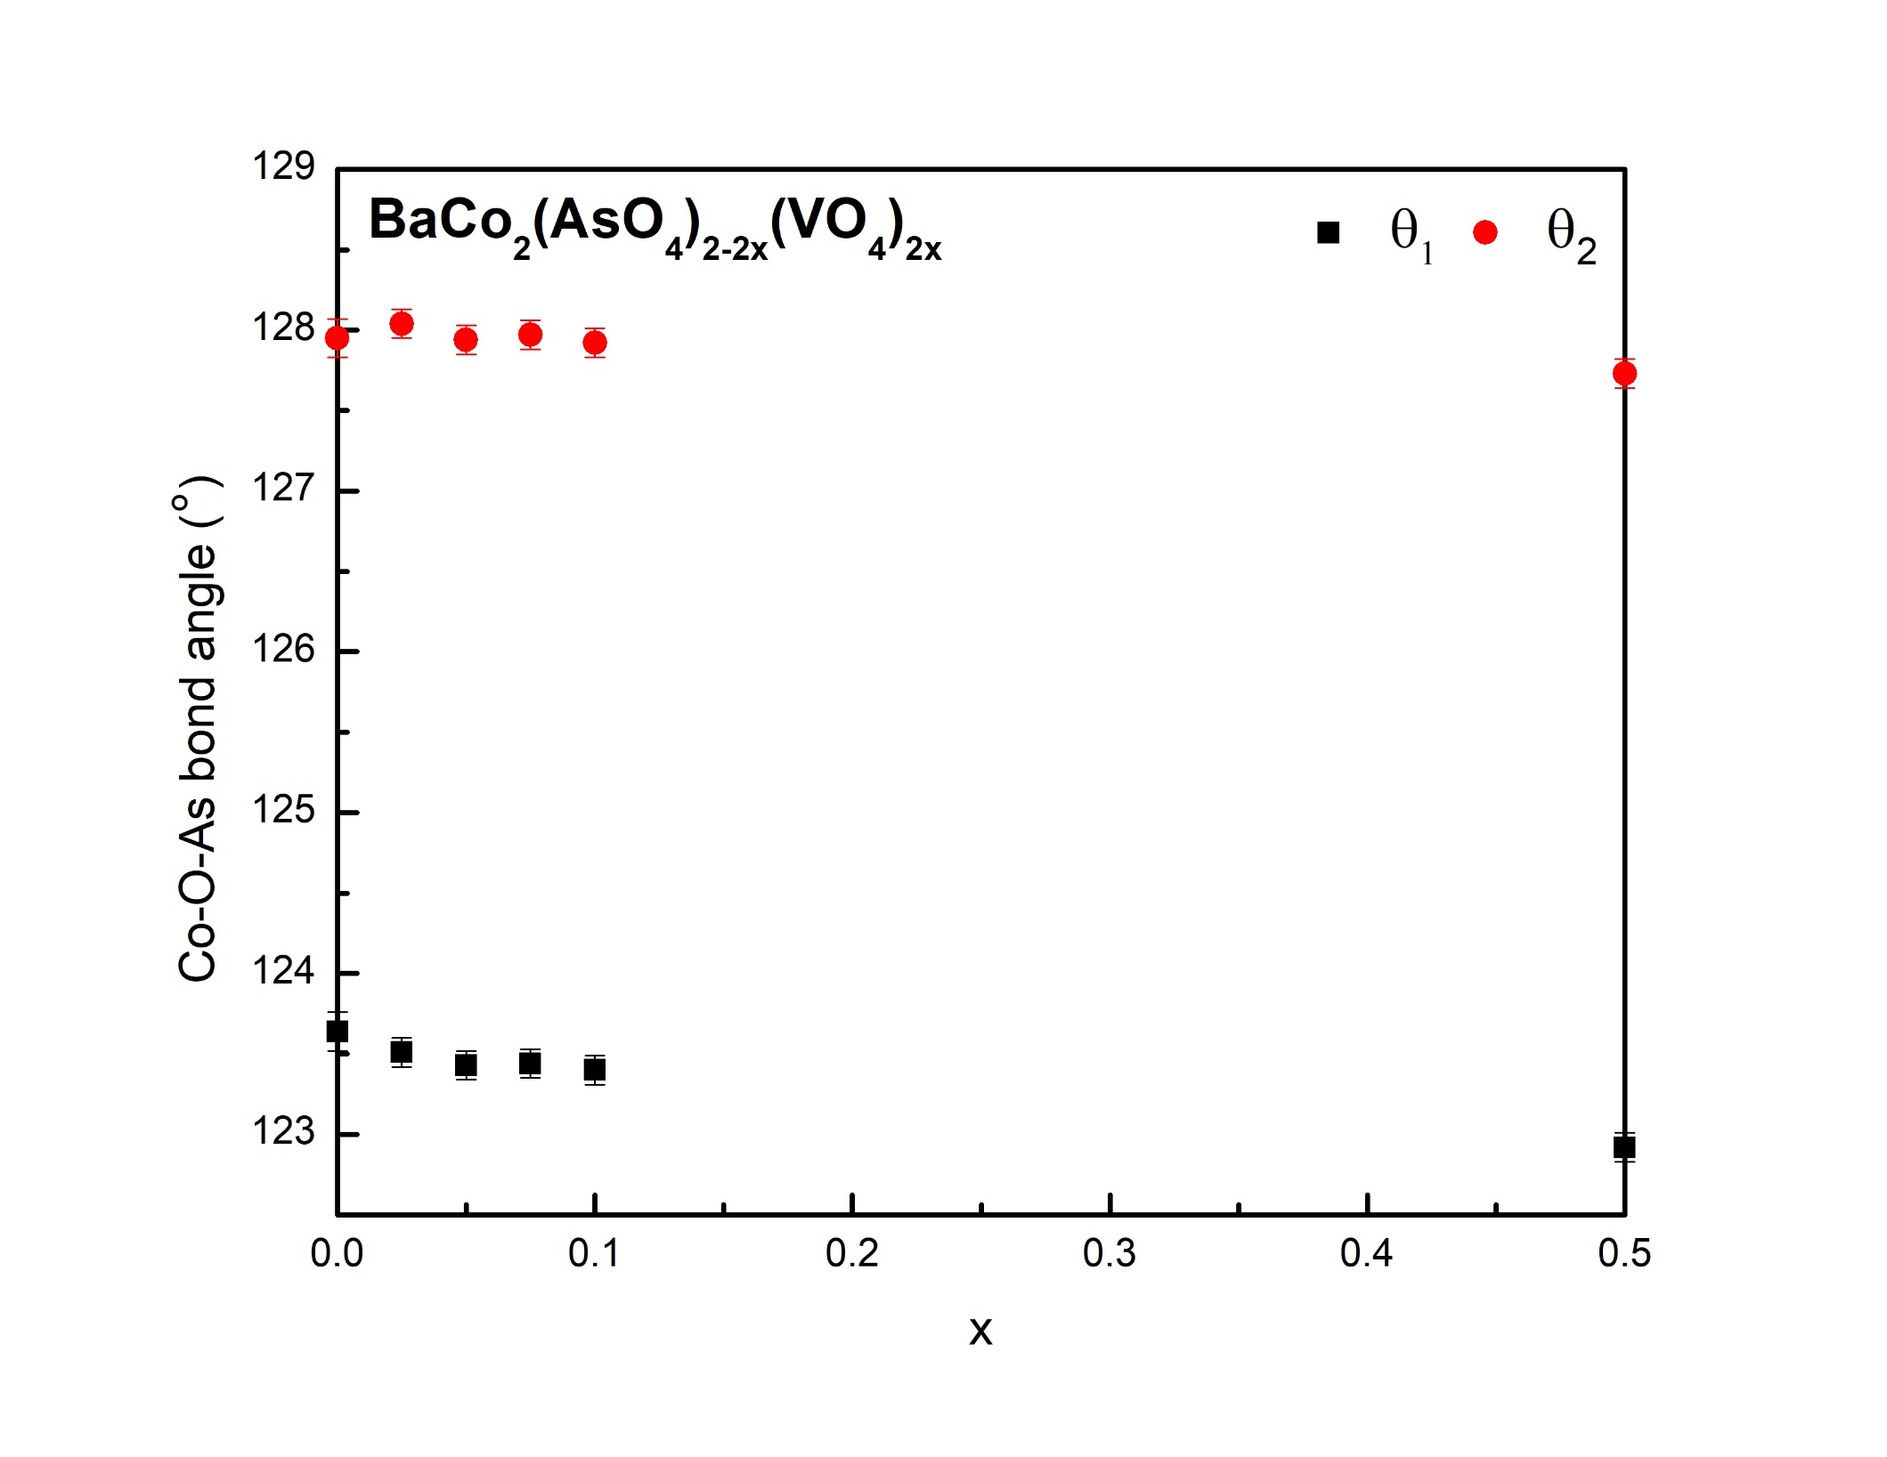
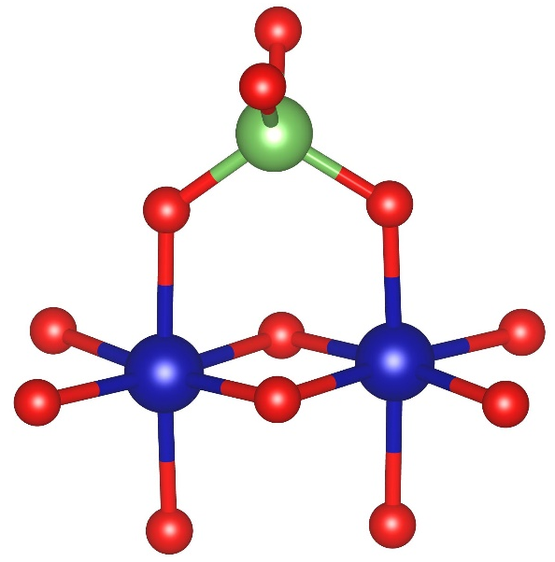
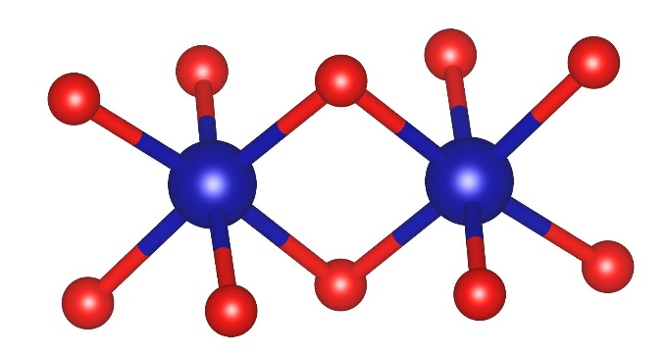
a)
b)
θ₁
θ₂
θ

Slide 14
From cifs derived from Rietveld refinements on second heat (melt) samples.
Large error bars of course, but seems to track roughly with gradual suppression of the order up to 7.5% V, more interesting behavior at 10-15% V, and gradually more glassiness/BCVO behavior.
  If the 10% trigonal distortion is actually smallest, that might make some sense?
  General trends, not correlated.
Likely won’t include - error bars from the refinements likely too large to get this info directly.

Slide 15
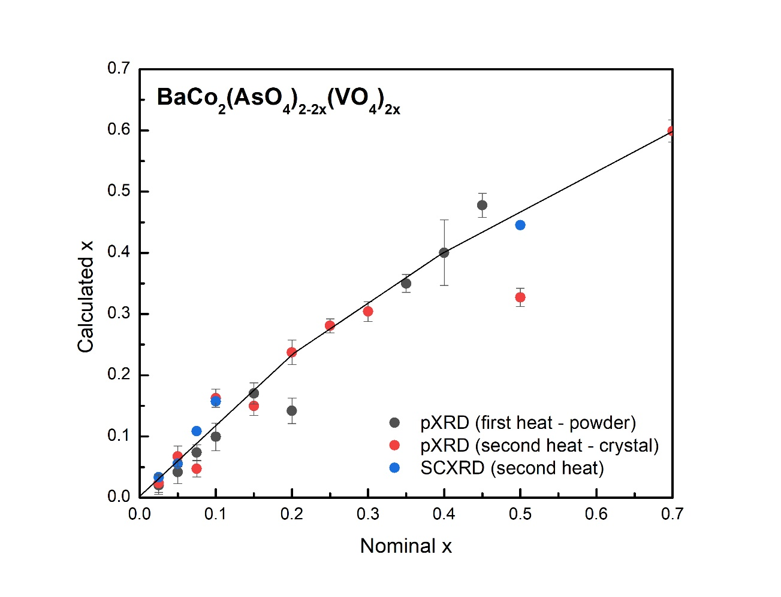
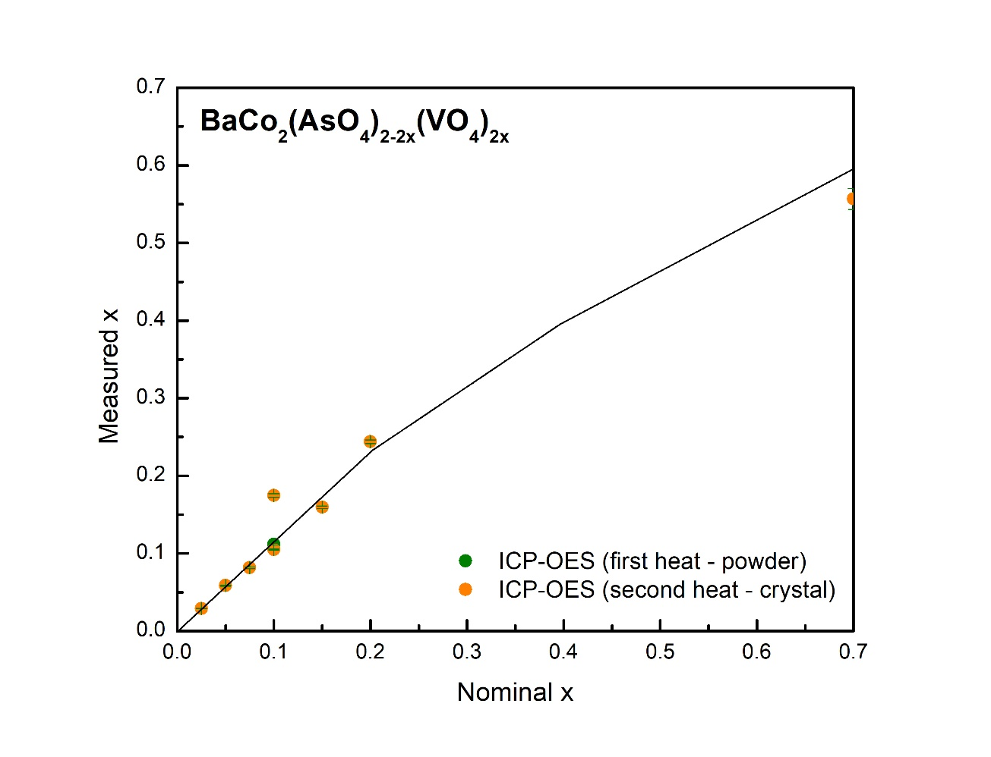
a)
b)

Slide 16
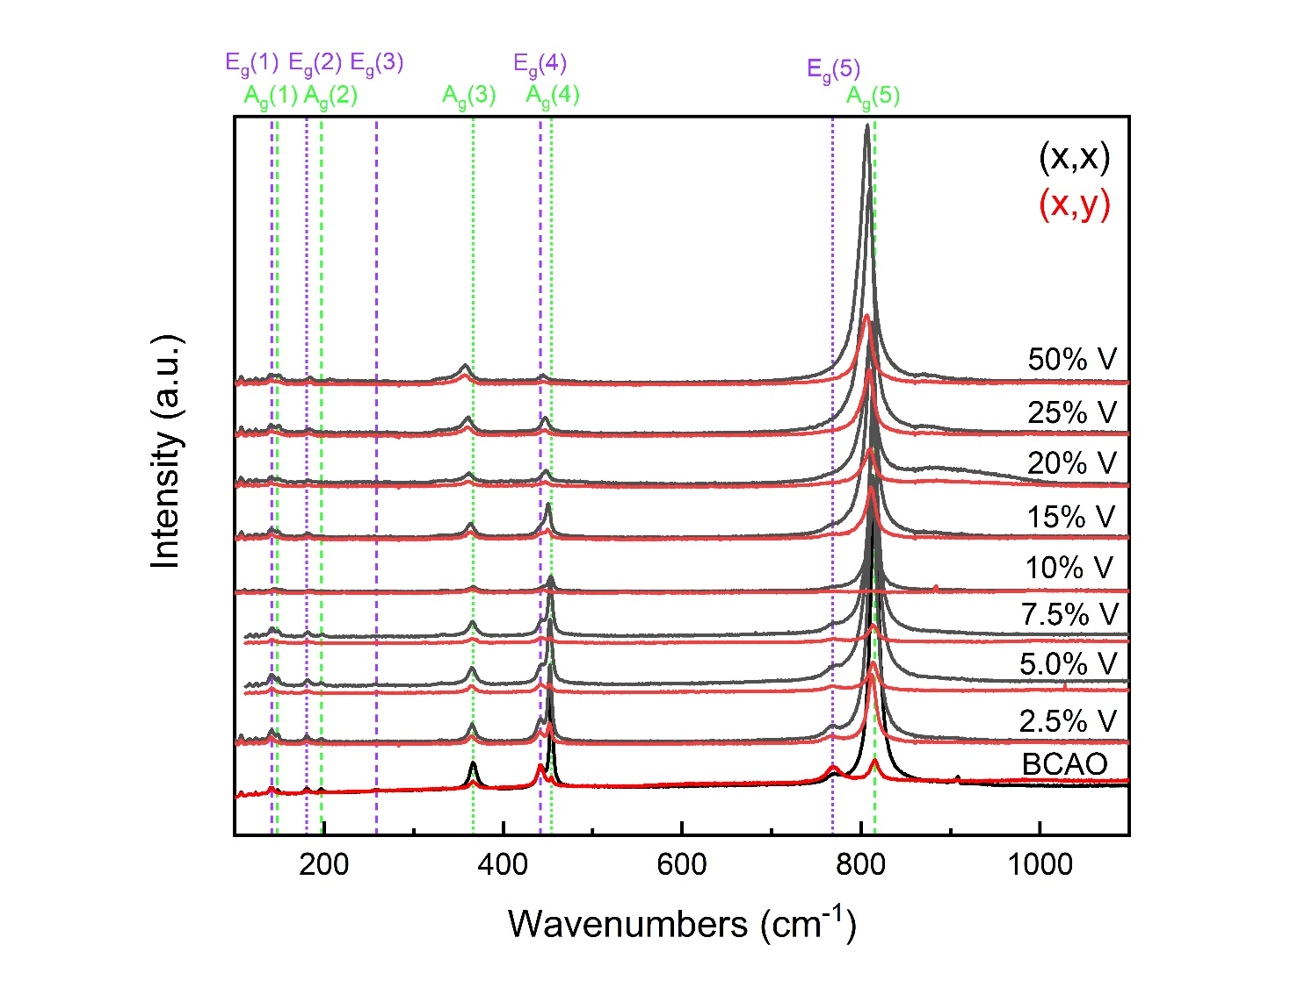
Notes:
4 A1g modes from oxygen, 1 A1g mode for Co/As respectively.

Slide 17
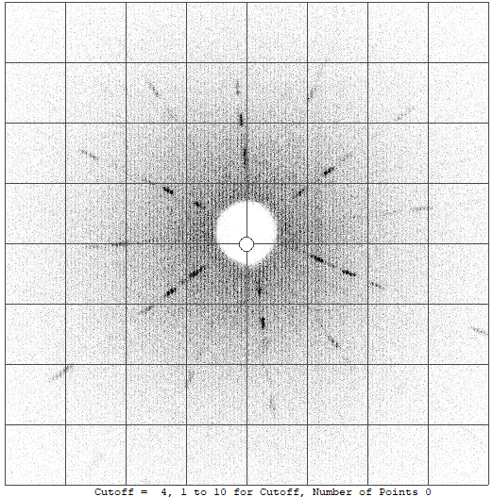
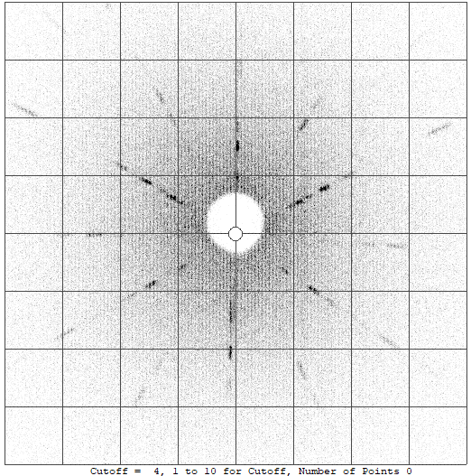
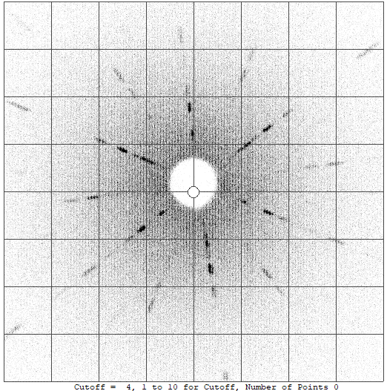
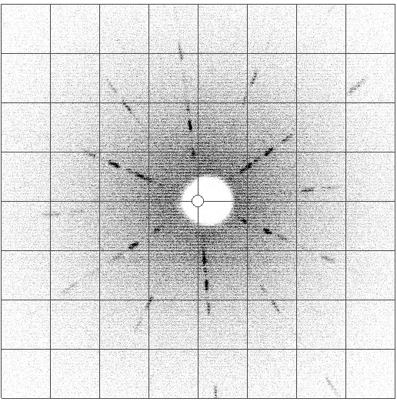
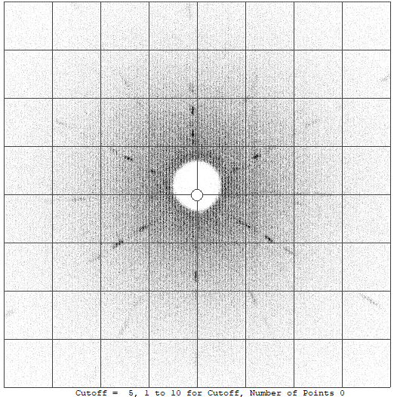
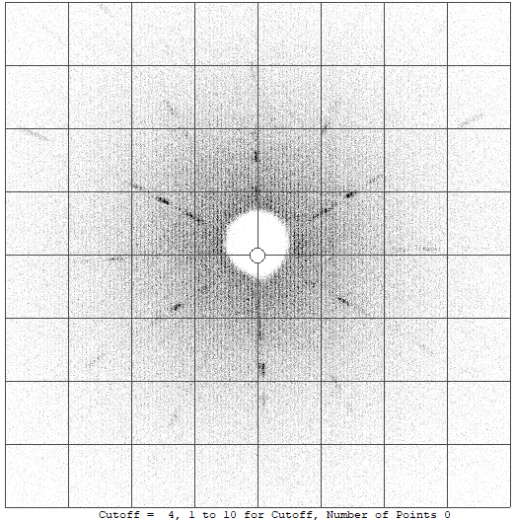
a)
BaCo₂(AsO₄)_{2-2x}(VO₄)_{2x}
b)
c)
[1 -1 0]
[1 -1 0]
[1 -1 0]
[-1 0 0]
[-1 0 0]
[-1 0 0]
(h k 0)
x = 0.025
(h k 0)
x = 0.05
(h k 0)
x = 0.075
d)
e)
f)
[1 -1 0]
[1 -1 0]
[1 -1 0]
[-1 0 0]
[-1 0 0]
[-1 0 0]
(h k 0)
x = 0.10
(h k 0)
x = 0.15
(h k 0)
x = 0.20
x = 0.15

Slide 18
(x,x) singlet modes
Relative to the (x,y) polarization, only the A_{g}(6) mode follows a similar trend (shift to lower frequency, slight broadening).
The A_{g}(2) and A_{g}(3) modes are very weak, and are not visible at higher V concentrations.
For the A_{g}(1) and A_{g}(4) modes, the 10% V sample shows a sharper shift to higher frequency, with no significant broadening.

Slide 19
(x,x) doublet modes
The 10.0% V sample shows all doublet modes at a higher frequency (a local maximum in terms of V-content).
These modes seem to generally agree with magnetization/specific heat measurements showing this composition to be at some critical point in the series.
The frequency shift of doublet modes beyond 10% sub. varies.
The E_{g}(2) mode shows significant broadening, while the E_{g}(3), E_{g}(4), and E_{g}(5) modes show a slower broadening.

Slide 20
(x,y) singlet modes
The A_{g}(1), A_{g}(4), and A_{g}(5) modes both shift to lower energy and broaden upon increasing V-content.
The 10% V sample shows either a much sharper shift to lower frequencies, or no mode at all in the case of the A_{g}(2) and A_{g}(3).

Slide 21
(x,y) doublet modes
The 10.0% V sample shows only the E_{g}(1) and E_{g}(2) (a local maximum in terms of V-content).
  The E_{g}(4) mode also isn’t visible for this sample.
The frequency shift of doublet modes beyond 10% sub. varies.
The E_{g}(1), E_{g}(2), and E_{g}(3) modes don’t broaden much, but the E_{g}(4), and E_{g}(5) modes broaden significantly above 10% V.
  At 10% V, these are also the narrowest or not present.

Slide 22
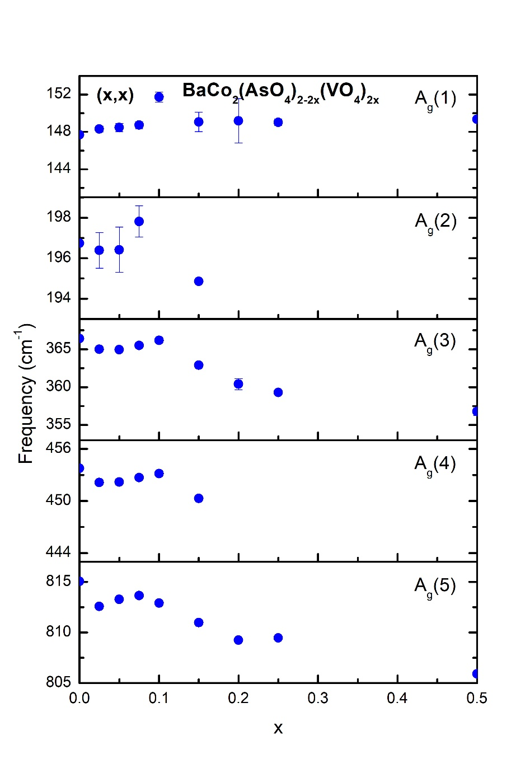
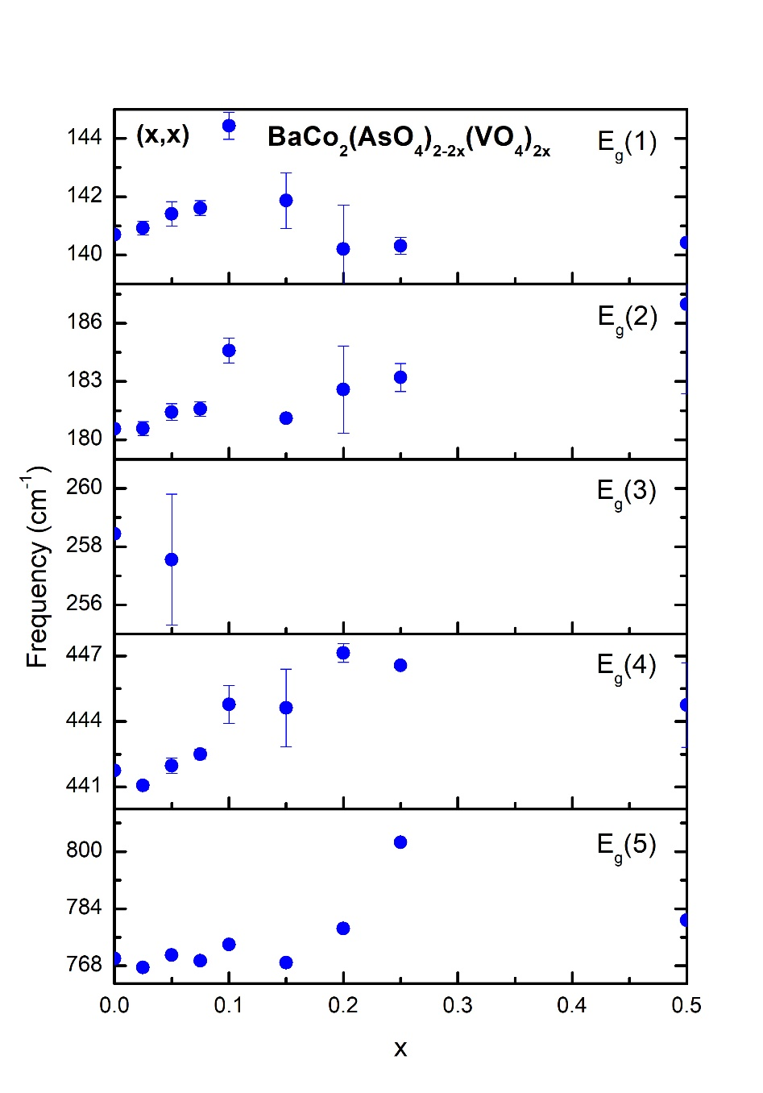
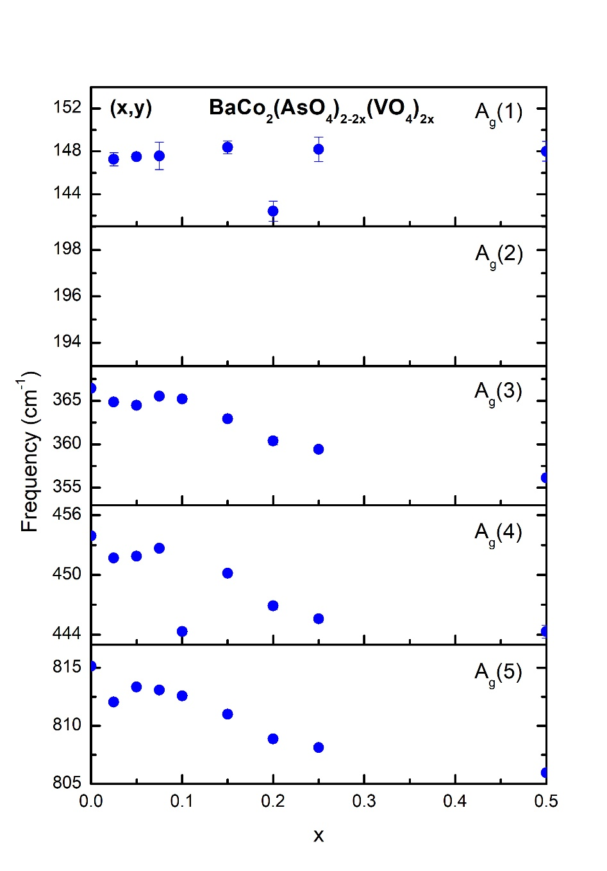
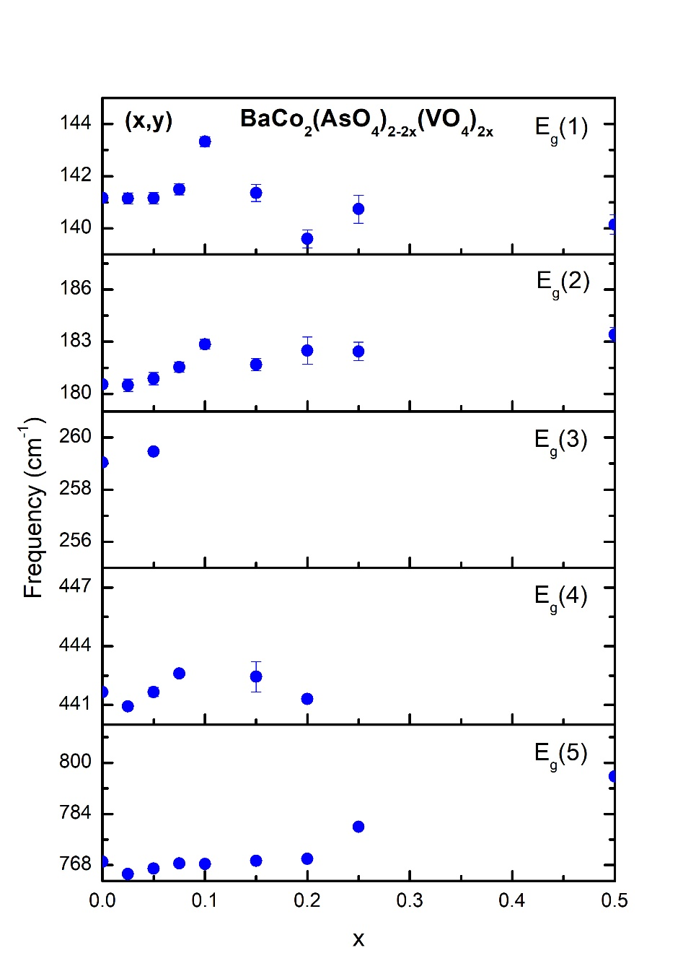
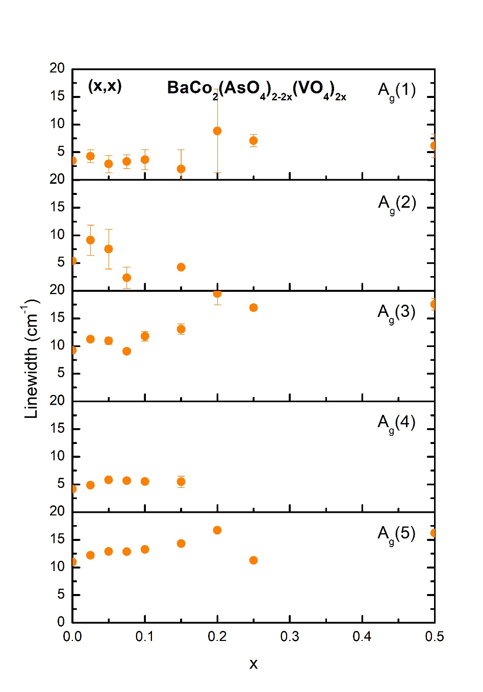
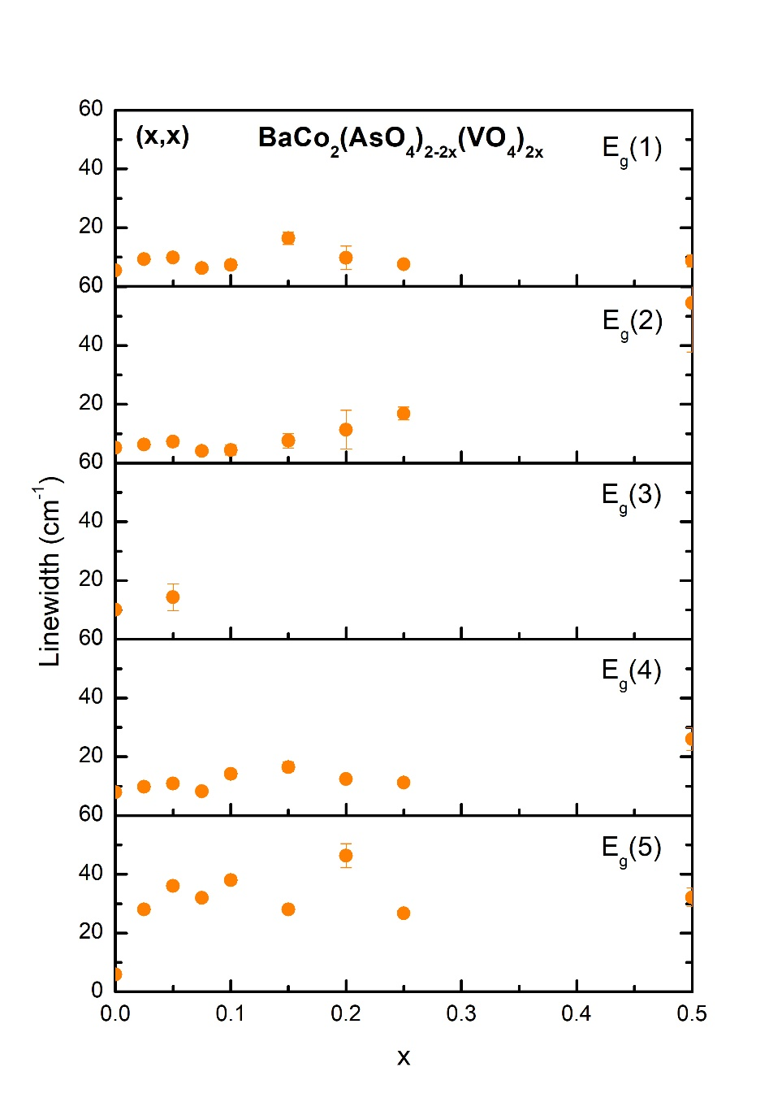


a)
b)
c)
d)
e)
f)
g)
h)

Slide 23


a)
b)

Slide 24






a)
b)
c)
d)
e)
f)

Slide 25






a)
b)
c)
d)
e)
f)

Slide 26




a)
b)
0
0.025
0.05
0.075
c)
d)
0.10
0.15
0.20

Slide 27

x↑
x↑

Slide 28

x↑
x↑

Slide 29

0
0
0
0
0
0
0
0
0
0
0
0

Slide 30

0
0
0
0
0
0
0
0
0
0
0
0

Slide 31



a)
b)
c)

Slide 32


Slide 33






a)
b)
c)
d)
e)
f)

Slide 34



f↑
f↑
f↑

Slide 35


f↑
f↑

Slide 36
a)
b)
c)
d)
e)
f)

Slide 37

Composition (nom.) | T_{f} (300 Hz) (K) | E_{a} (K) | ω₀ (Hz)
BCAO-10% V | 2.73 | 85.0 | 1.06 x 10¹⁶
BCAO-15% V | 2.63 | 53.7 | 2.16 x 10¹¹
BCAO-20% V | 2.79 | 56.8 | 2.14 x 10¹¹
E_{a} = average thermal activation energy;
ω₀ = characteristic frequency
For conventional glassy systems, ω₀ ≈ 10¹⁰- 10¹³
Cluster glasses closer to ω₀ ≈ 10¹⁶

Slide 38


Slide 39

x↑

Slide 40


Slide 41


Slide 42
a)
b)
c)
d)
e)
f)

Slide 43






a)
b)
c)
d)
e)
f)

